Slide 1
Better Together Evaluation Methods

Slide 2
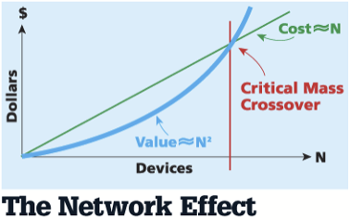
Network Effects: What is the Power of Scale?
Lack of focus on the network and time-dependent nature of papers
Text-based similarity
Doesn’t capture the potential power of the full network
Metcalfe's Law: cost scales in N, benefit scales in N^2
How great are the network effects for the citation graph?

Slide 3
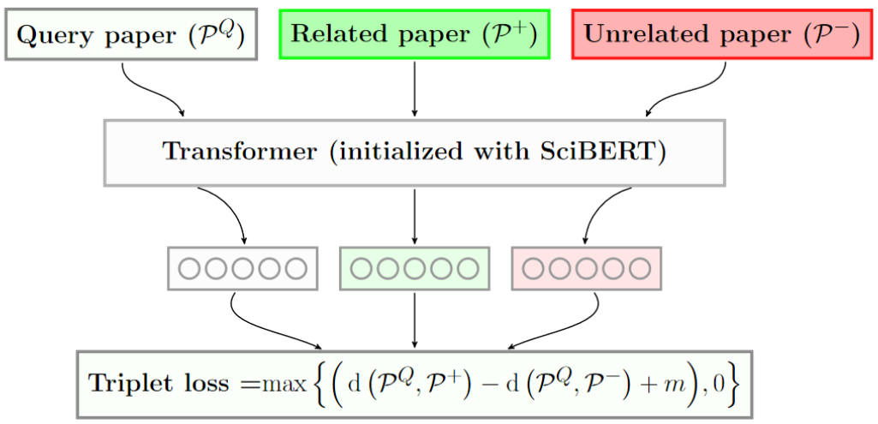
Overview: Text-based Similarity Approaches
Approaches:
Fine-tuning LM
Text similarity learned through triplet loss
Pros:
Easy to fine-tune
High accuracy results for subset of the whole data
Cons:
Expensive maintenance over time
Hence no maintenance became a habit
Models are more surprised looking into future (high perplexity)
Being halfway effective solution when the problem has a graph nature
Graphs are expensive but effective

Slide 4

What is the Effect of Scale and Time?
Hypothesis: As data is increased, (ProNE + text-embedding) should overtake compare to text-embedding or ProNE method alone for document representation in downstream tasks.
Partitioning the document graph to study the effect of increasing scale for graph models
Observing the point that the quad (n^2) effect of graph surpass the linear (n) effect of other methods
ProNE: Cost = n^2 memory and gains = n^2

Slide 5
Standard Graph Partition Recipes
No sense of causality
-Standard partition implies that when we model a document, we can see its citations way into the future
Random elimination of edges of the entire graph
-the task is to predict them
NOT forecasting, more like error correction
Current need: predicting trends into the future
-How can we partition the data for this?
-How can we quantify forecast ability?

Slide 6
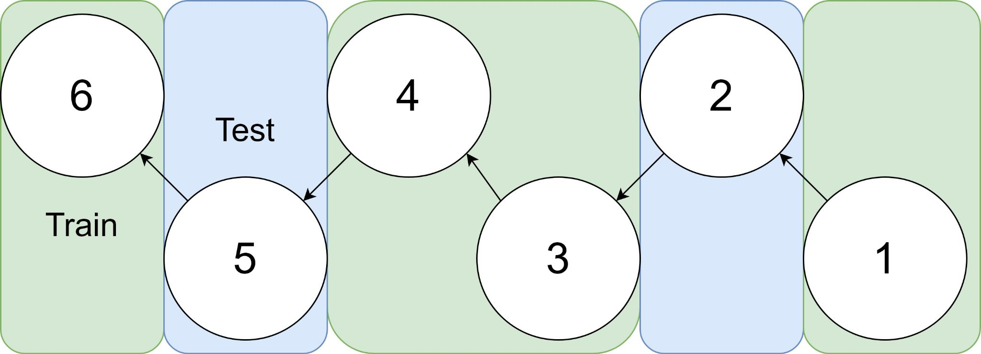
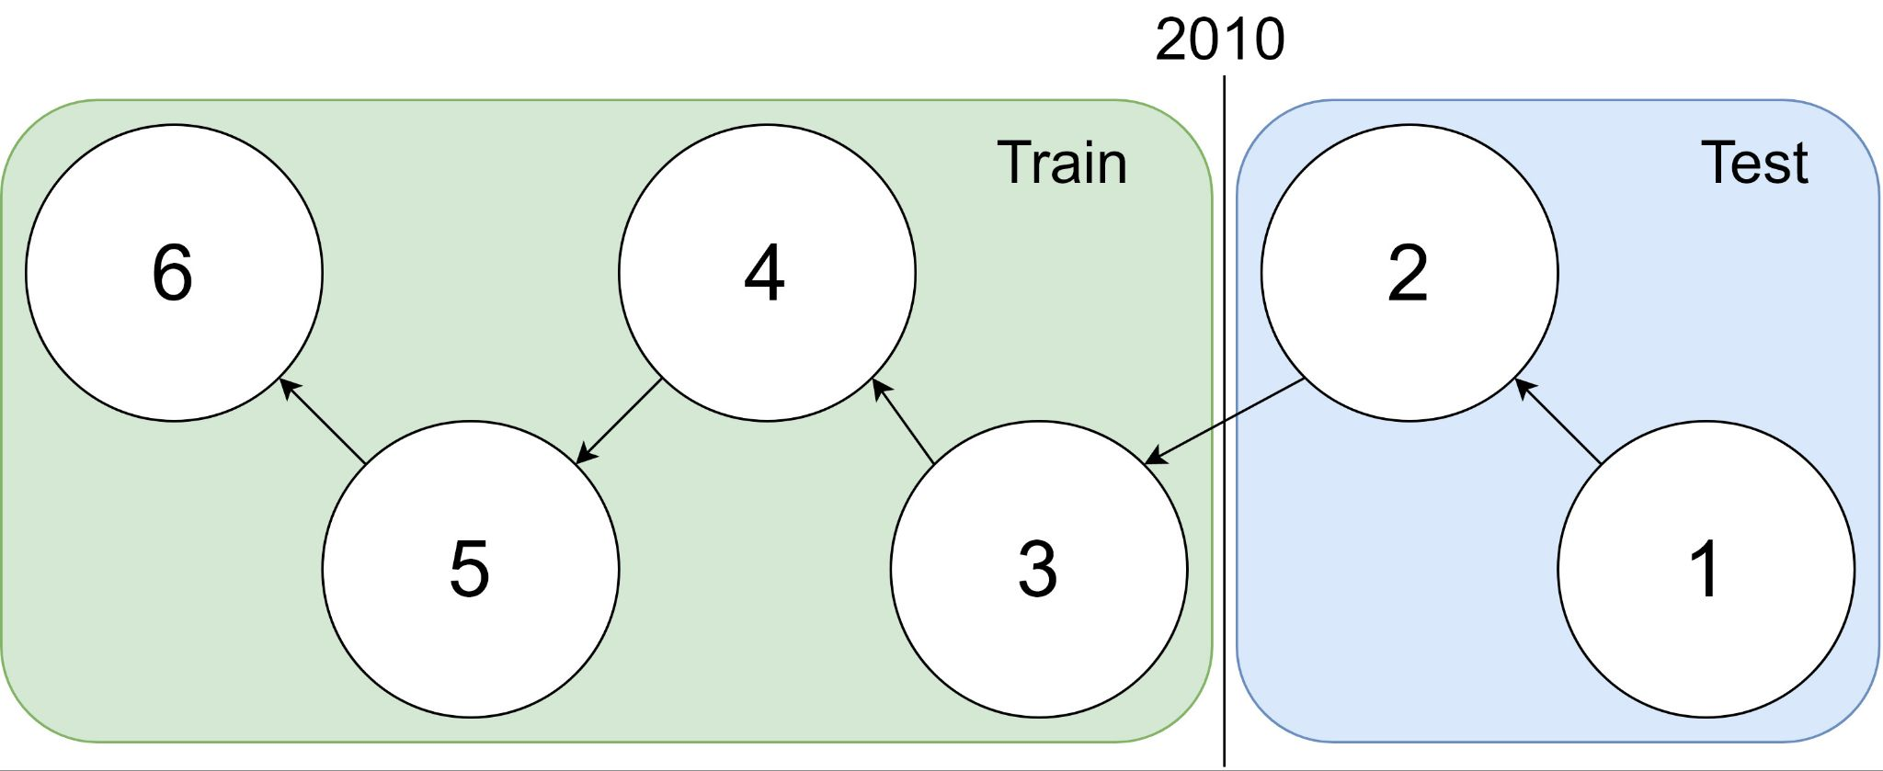
Graph Sample
Traditional Train-Test Split
idx | Pub Year | Paper Title
1 | 2018 | [...] Photofragment imaging
2 | 2016 | Convenient probe of S(1D2)[...]
3 | 2005 | Megapixel ion imaging [...]
4 | 2003 | Direct current slice imaging [...]
5 | 1995 | profiles of Cl(2Pj) photofragments [...]
6 | 1988 | Adiabatic dissociation of [...]
Causality Respecting Train-Test Split
Notes:
No asymmetry of time - how to reduce to a soundbite
Audience soundbites
‘Almost all studies in ml do test-train split’ that’s a bad idea when you have time

Slide 7
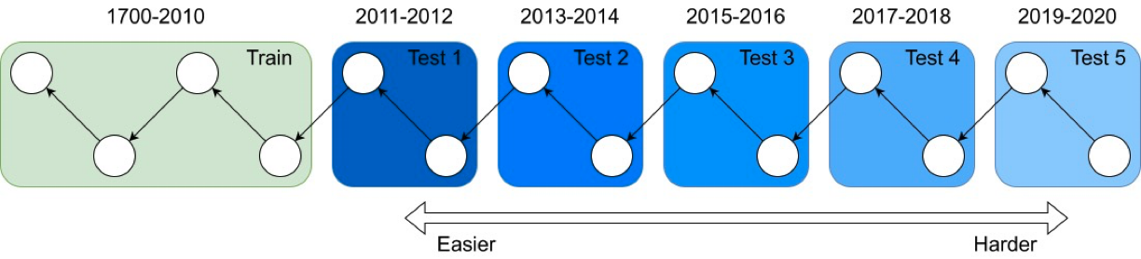
Partitioning for Forecasting
-Training in certain years
-Predicting is more difficult as we advance more in time, intuitively predicting the weather tomorrow is much easier compared to a year from now
-Quantifying forecasting ability by measuring task performance across test data from different times

Slide 8
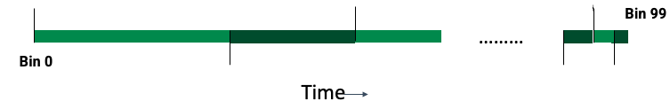
Network Effects: Data and Embeddings
Binning by time:
Split graph into 100 subgraphs by time
Cumulative graphs: each graph includes itself and all previous graphs
Embeddings:
Compute ProNE embeddings on cumulative graphs

Slide 9
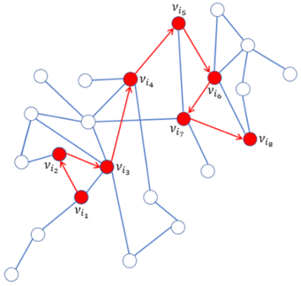
Intrinsic Evaluation - Random Walk Classification
Randomly pick start paper a
Jump to any referenced or citing paper
Repeat 1-4 times to reach final paper b
Verify the shortest path between a and b is in [1,4]
Hypothesis: representation models should have higher similarity for 1 hop than 2-4 hops.
It’s cheap to collect millions of random walks
Can also assign walks to bins which allows for forecast evaluation
Walk bin = max(a_bin, b_bin)

Slide 10
Intrinsic Evaluation - Random Walk Forecasting
Forecast set-up: partition the Semantic Scholar graph into 100 chronological bins
Pick a last train bin t such that bins 0-t are used for training, t+1-99 are for testing
How well do we remember links from the training set?
How well do predict links in the (future) test set?
Does this get harder as we get further away from t?

Slide 11
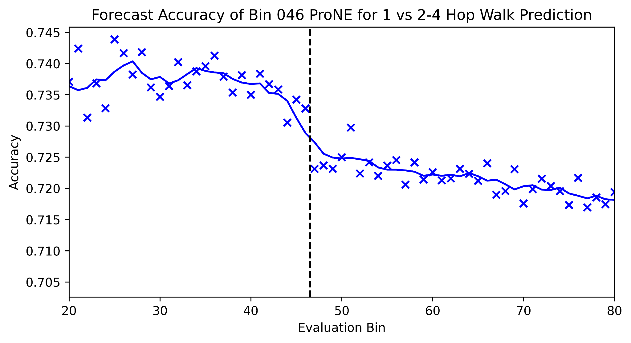
Forecasting from Bin 46

Slide 12
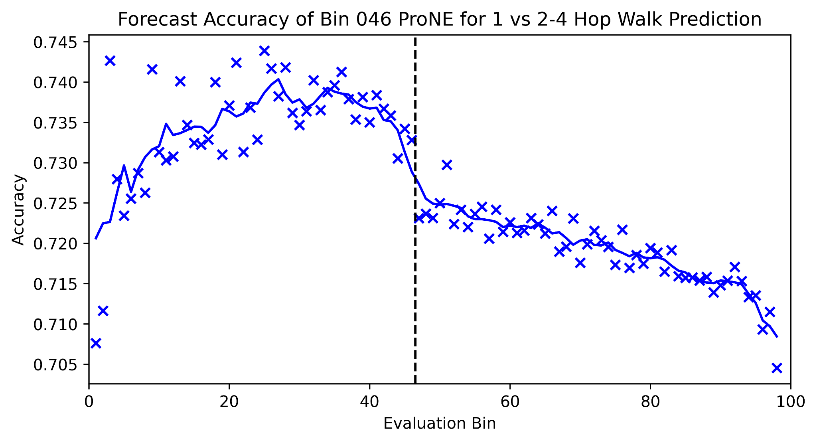
Forecasting from Bin 46 - Full Picture

Slide 13
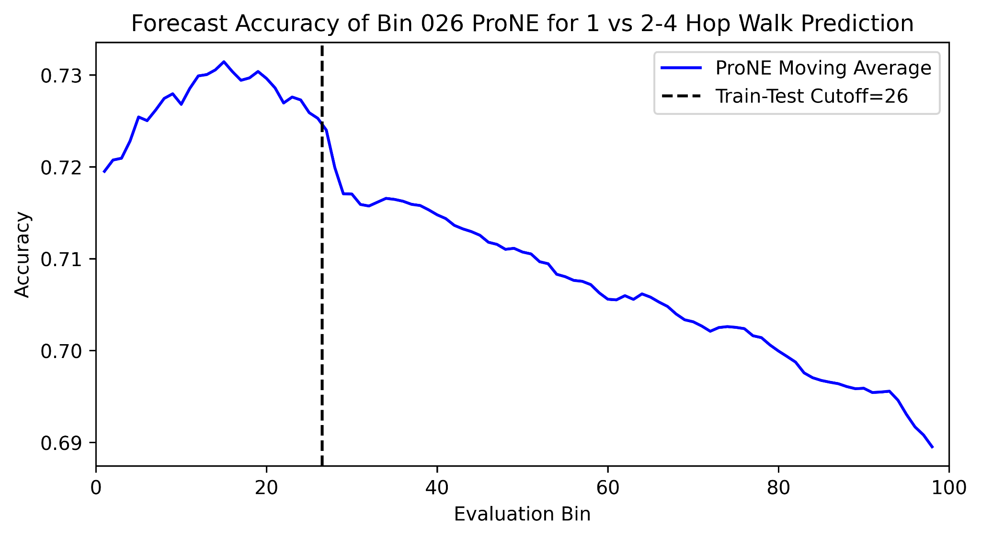
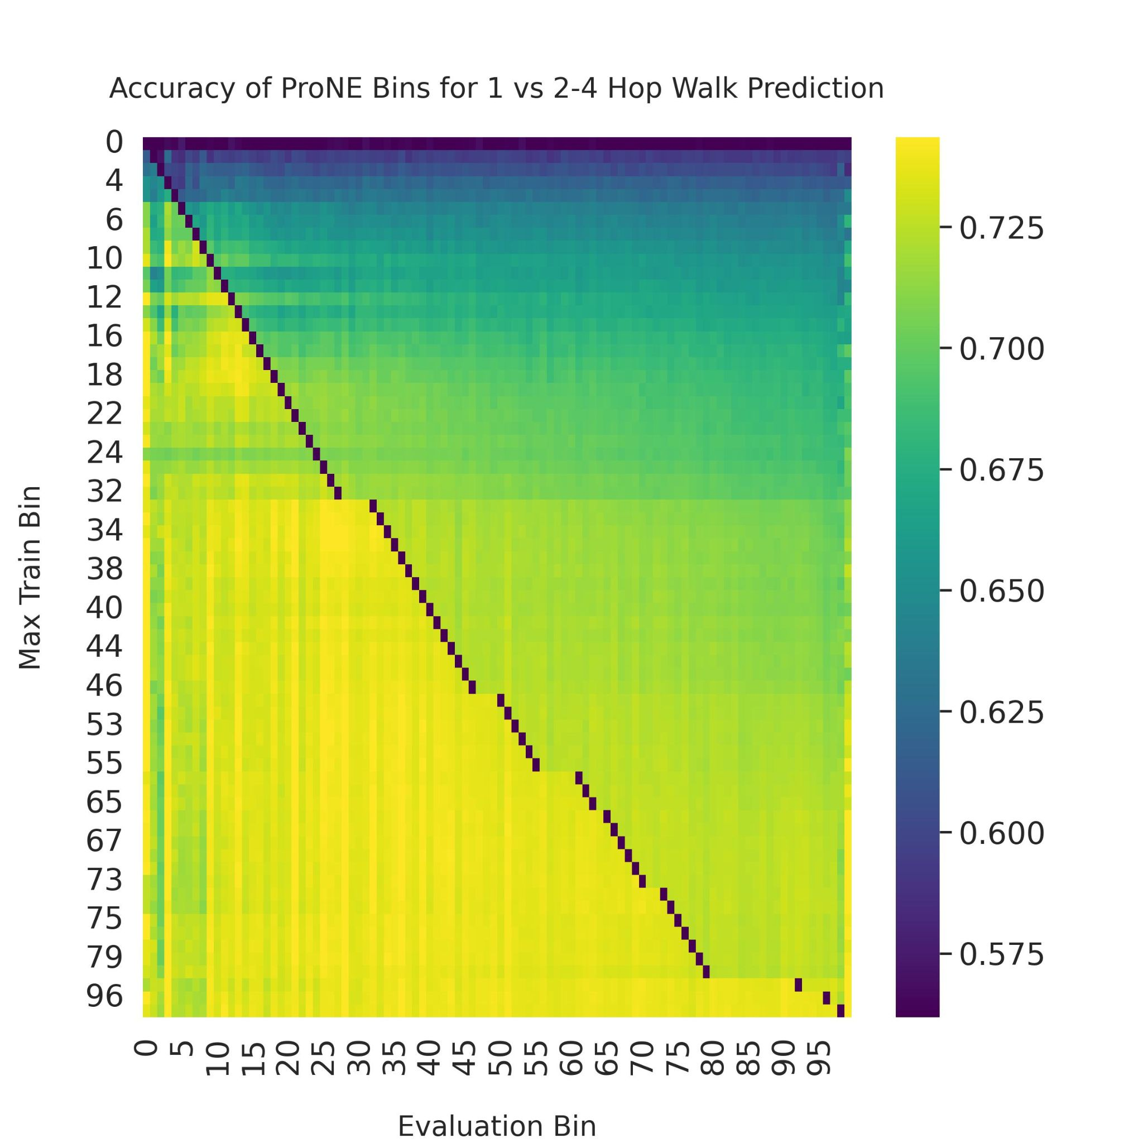
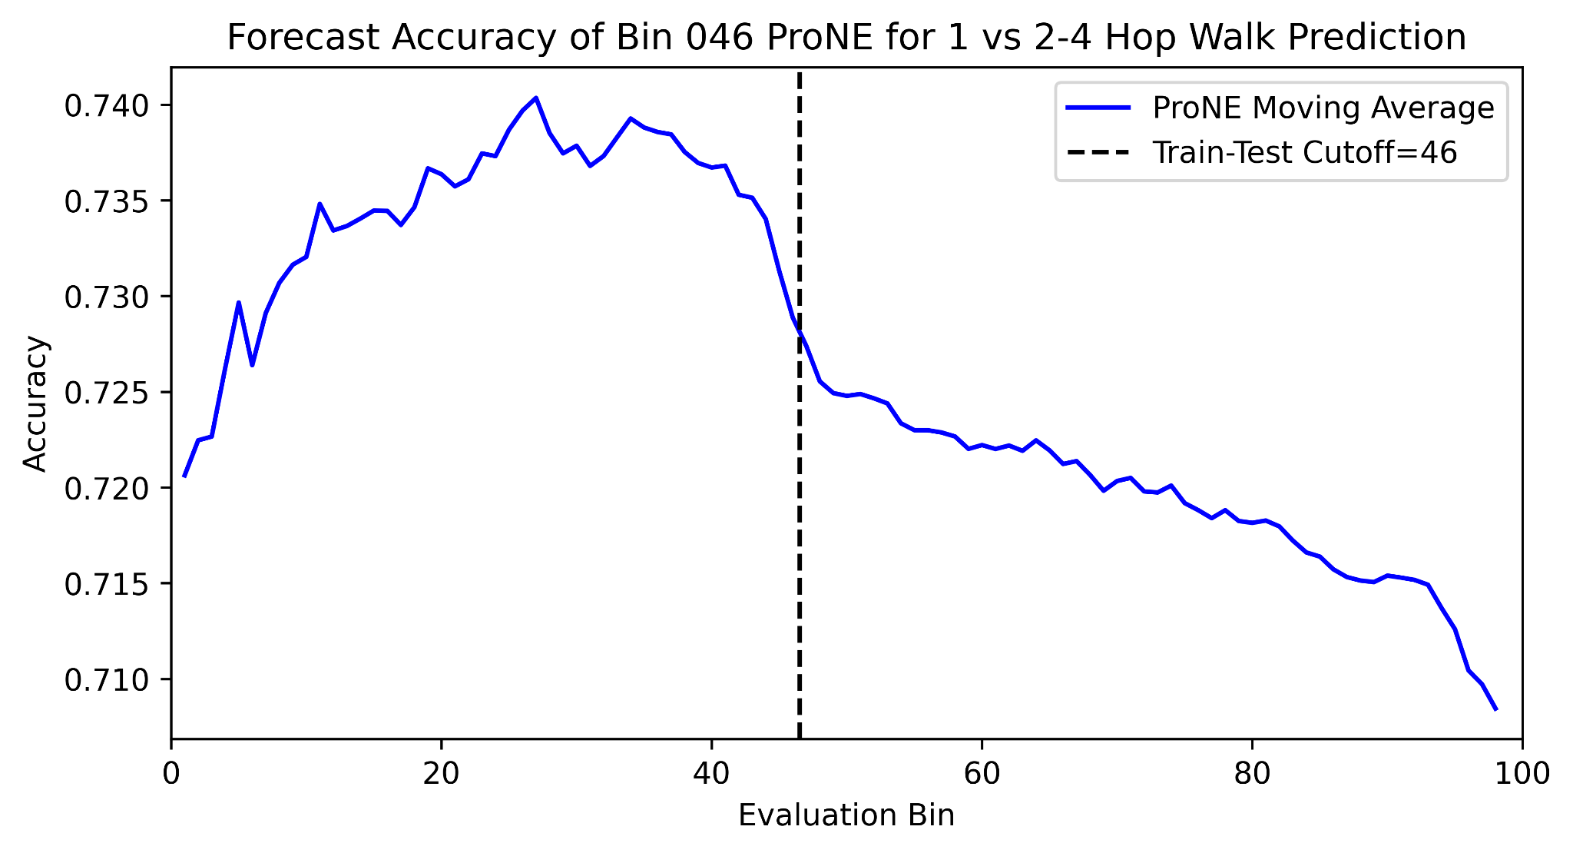
Forecasting for all Train-Test Splits

Slide 14
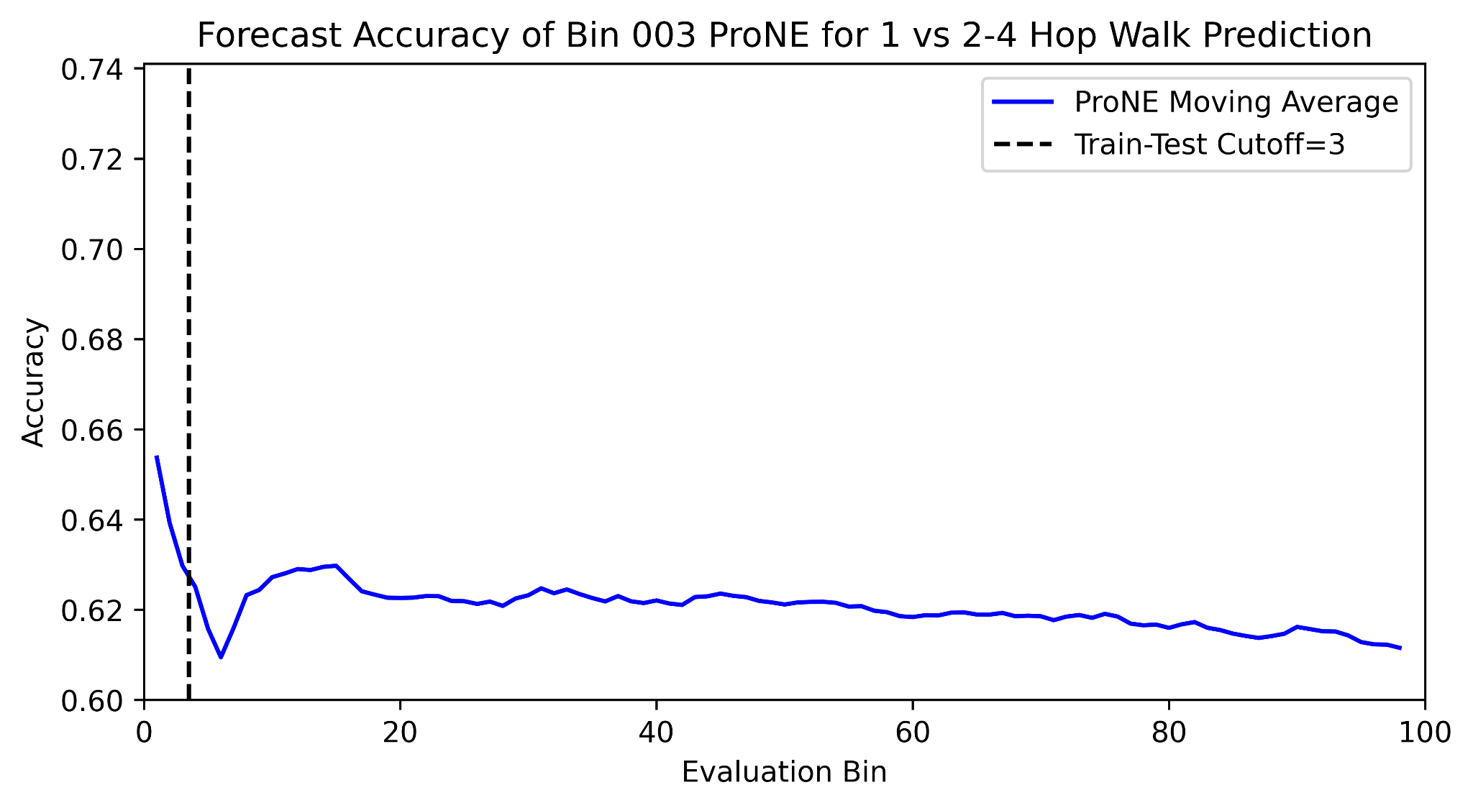
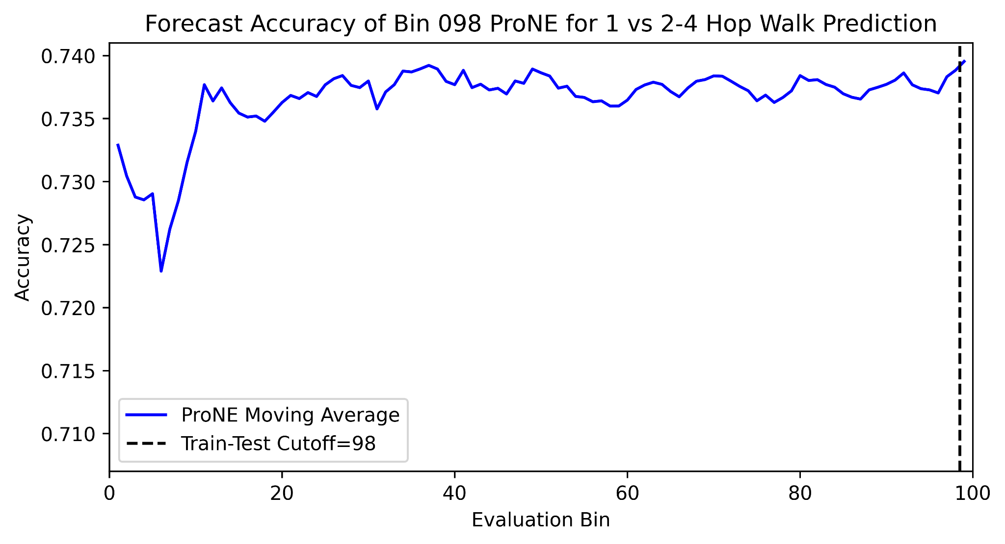
Forecasting for all Train-Test Splits - Extremes

Slide 15
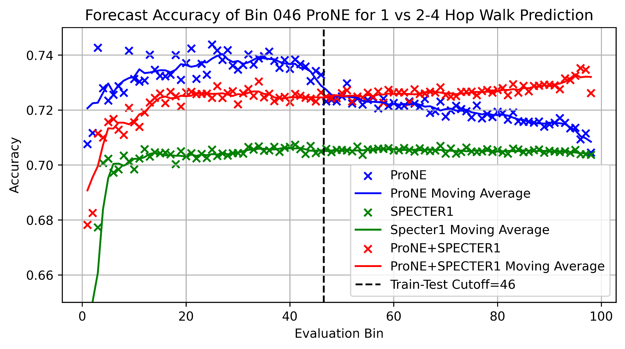
Text, Context, and Better Together

Slide 16
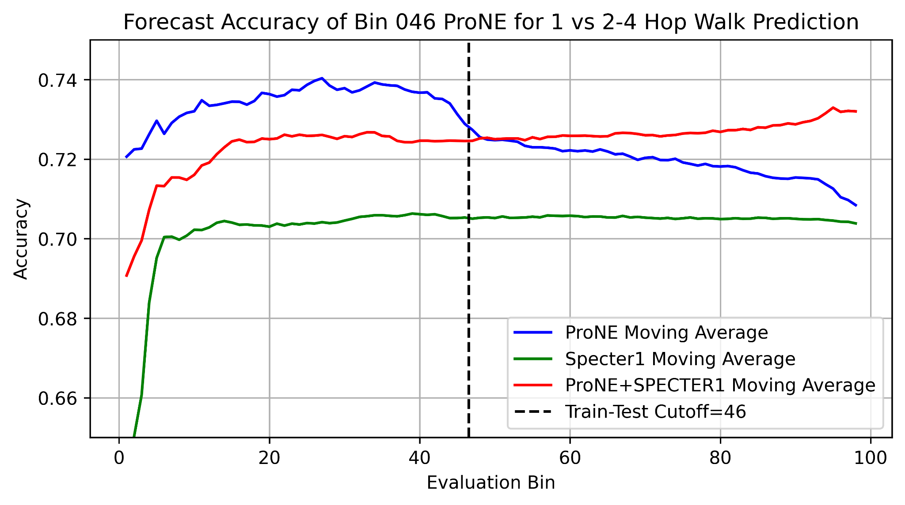
Text, Context, and Better Together

Slide 17
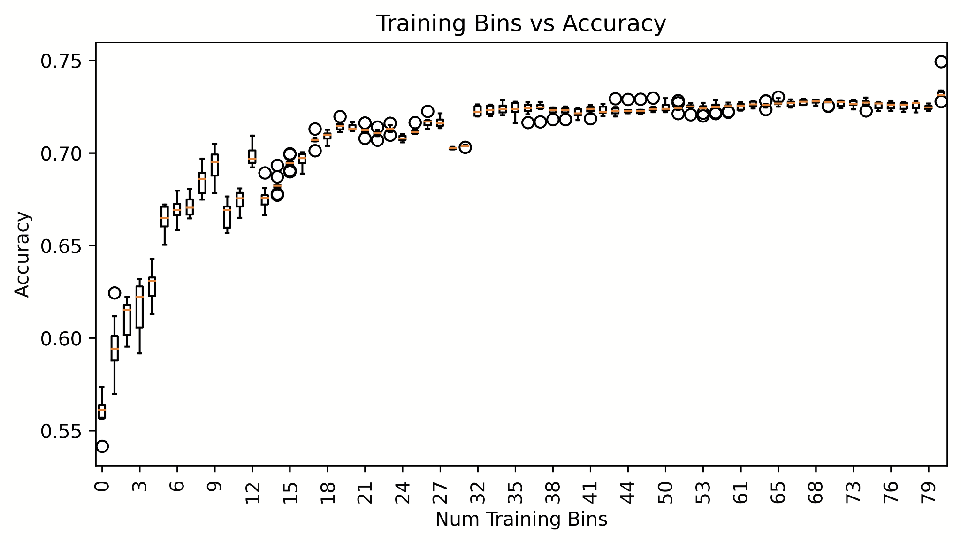

Slide 18
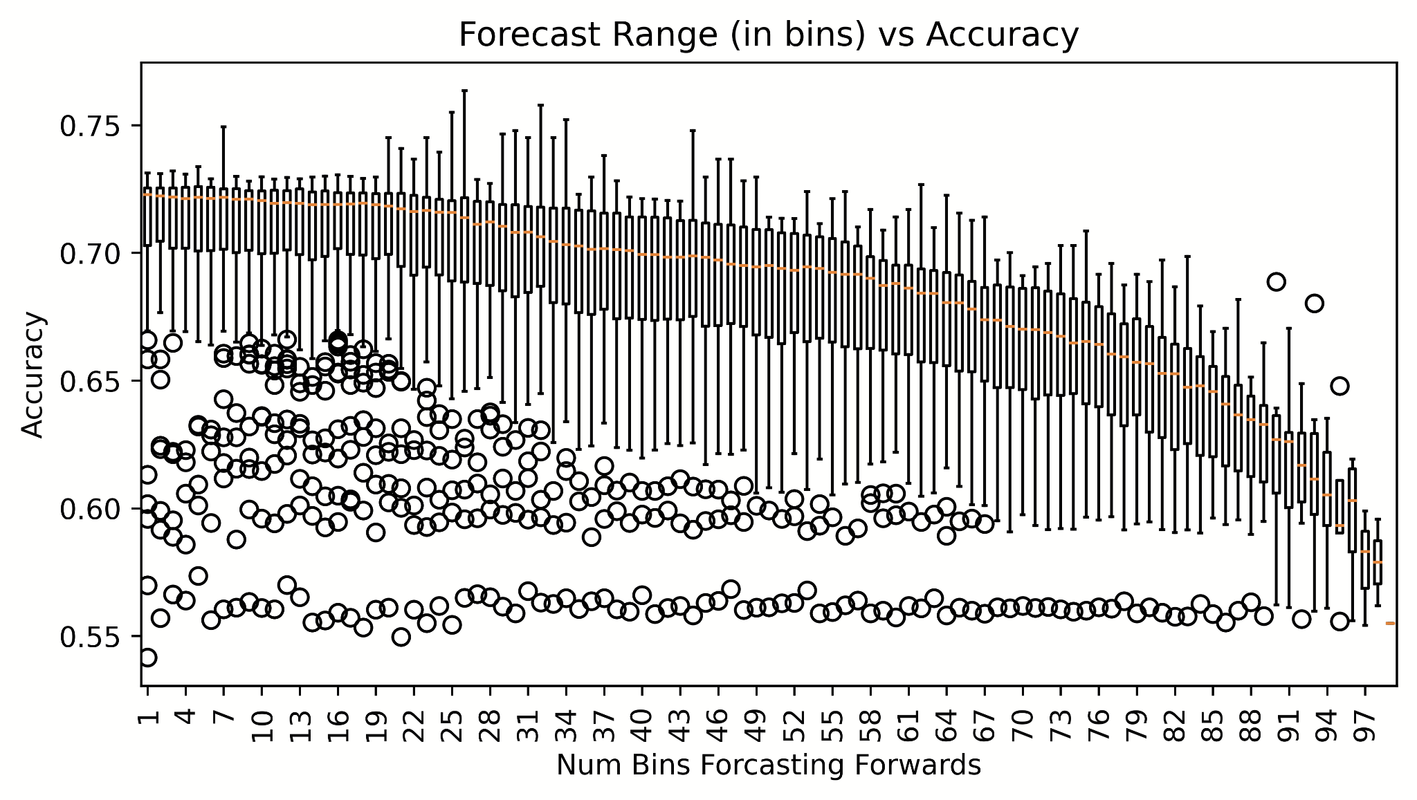

Slide 19
Across all Test/Train Splits
Looking across all ProNE bins we find:
The closer you train to a time point, the more accurate the model
The more time a model has seen from training, the better it does at some time point testtrain-split+k

Slide 20
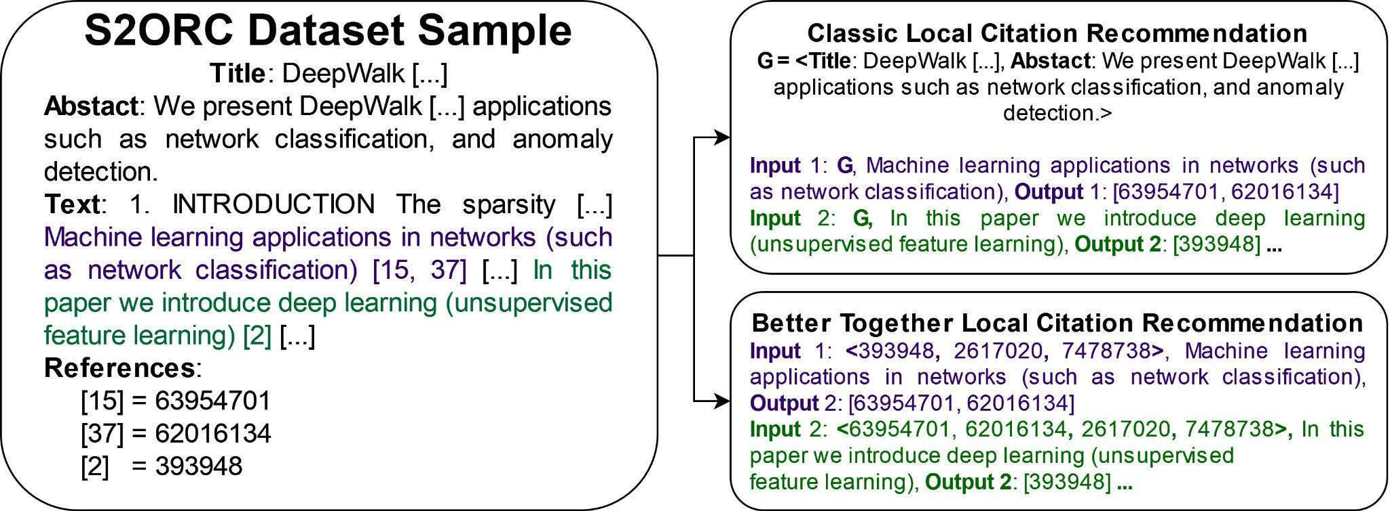
Extrinsic Evaluation – Local Citation Recommendation
Notes:
Refer to original paper before this. Link prediction refers to many things – earlier was one of simpler ones, whether i cites j. Introducing more complex problem
Reduce text
? answer, not q
use animations?
Emphasize task as predicting citations associated with citing sentence

Slide 21
Local Citation Recommendation Dataset
“What do I cite here?”
200M Papers, TK (>300M) citing sentences
Evaluation through nearest neighbour lookup of text/references
Record where in the retrieval list the ground truth reference appears
Can take the features of the source paper or other references
Can also weight features by their distance in the text document to the referencing sentence

Slide 22
Local Citation Recommendations - Text Vs Context
Specter1 Citing Sentences
Recall@1 0.0622
Recall@10 0.0988
Recall@100 0.1133
Recall@1000 0.1141
Specter2 Title + Citing Sentences
Recall@1 0.0033
Recall@10 0.0059
Recall@100 0.0067
Recall@1000 0.0067
SciNCL Source
Recall@1 0.0004
Recall@10 0.0143
Recall@100 0.0194
Recall@1000 0.0194
ProNE Source
Recall@1 0.0005
Recall@10 0.0684
Recall@100 0.1898
Recall@1000 0.2717
ProNE References
Recall@1 0.0093
Recall@10 0.0705
Recall@100 0.2068
Recall@1000 0.3068
ProNE References Weighted
Recall@1 0.01
Recall@10 0.0771
Recall@100 0.2156
Recall@1000 0.3195

Slide 23
Deliverables
Plots
Benchmarks
Tasks
Shared Embeddings
“How can we enable others to do the things we didn’t”
Open problems

Slide 24
Document Time Period Prediction

Slide 25
Time Period Prediction – Task Overview
Given a query paper, predict the time period (time bin) it comes from
Input: single scientific paper
Embeddings: Specter, Specter 2, SciNCL, ProNE
References of query paper, along with information such as publication year
Similar documents to query paper
Map of year to time bin
Output: Predicted time bin
Bin 99
………
Bin 0
Time

Slide 26
Time Period Prediction – Motivation
Understand contribution of embedding types and nearest neighbors on predicting information about query paper
Detect missing or incorrect data
Many papers in dataset cannot be found in semantic scholar
Some papers are recorded to cite far into the future
Proxy for many other related tasks
Venue prediction
Reviewer matching
Collaborator search
???

Slide 27
Time Period Prediction – Experiments Overview
Baseline – References
Similar Papers – Nearest Neighbors
Embeddings
ProNE: citations
Specter: text
Specter 2: text
SciNCL: text
Combination

Slide 28
Time Period Prediction – Data
Bigrams:
Cosine similarity, query paper corpus ID, and list of similar papers to query
(0.9984, 4336316, 121417552)
(0.9970, 4336316, 15371799)
(0.9966, 4336316, 4239637)
(0.9953, 4336316, 117876280)

Slide 29
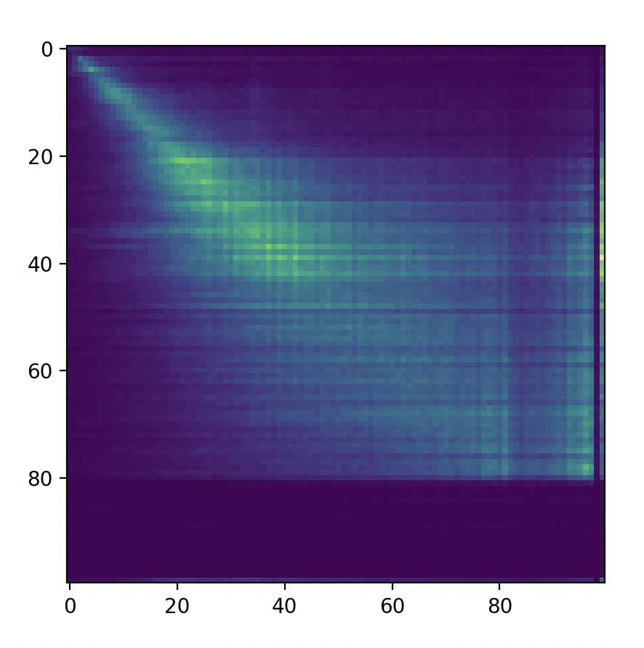
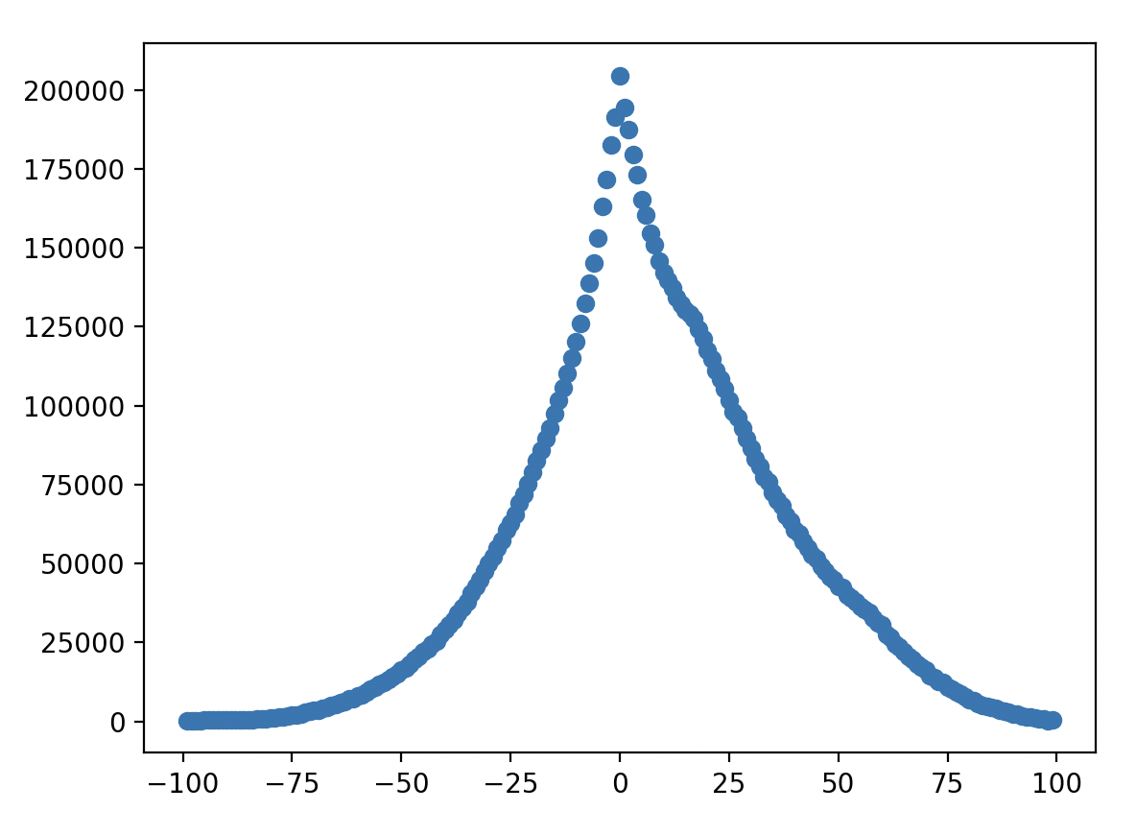
Time Period Prediction – Initial experiments
Count of Citations by Bin Number
Sum of Count of Citations at each Bin Offset
Paper 2 Bin
Count
Paper 1 Bin
Bin Offset

Slide 30
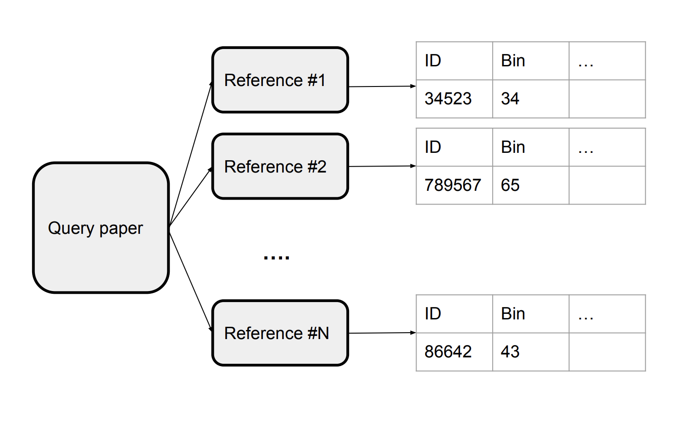
Time Period Prediction – Baseline
Use bin of most recent reference as predicted bin of query paper
Semantic Scholar API
max()

Slide 31
Time Period Prediction – Baseline Results
Method | Accuracy | Cumulative Acc | Precision | Recall | F1
Bin # of most recent reference | 18.80 | 18.80 | 0.21 | 0.19 | 0.19
Bin # of most recent reference + 1 | 20.45 | 39.25 | 0.23 | 0.20 | 0.21
Bin # of most recent reference + 2 | 13.08 | 52.33 | 0.14 | 0.13 | 0.13

Slide 32
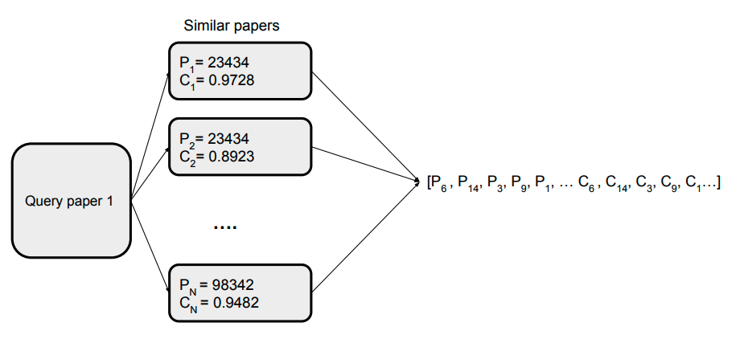
Time Period Prediction – Similar Papers

Slide 33
Time Period Prediction – Similar Papers Results
Method | Accuracy | Precision | Recall | F1 | MSE
Top 10 by cosine | 7.57 | 0.07 | 0.08 | 0.06 | 186.74
Top 5 by cosine | 7.51 | 0.07 | 0.08 | 0.06 | 204.32
Top 1 by cosine | 6.99 | 0.08 | 0.07 | 0.06 | 292.52

Slide 34
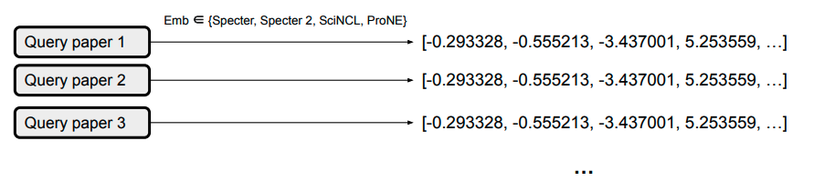
Time Period Prediction – Embeddings

Slide 35
Time Period Prediction – Embeddings Results
Method | Accuracy | Precision | Recall | F1 | MSE
Specter | 33.7
Specter 2 | 24.6
SciNCL | 21.5
ProNE | 35.5

Slide 36
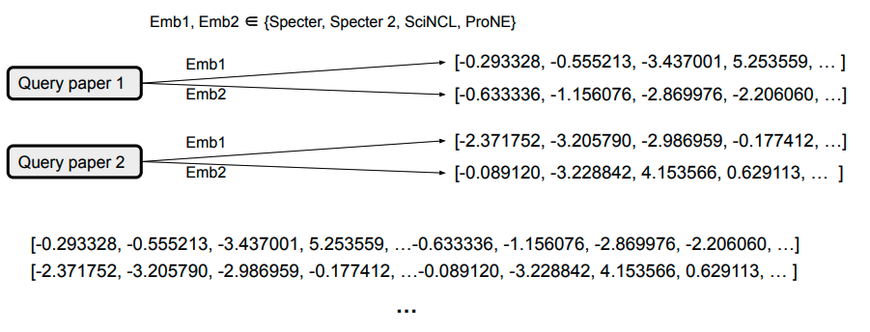
Time Period Prediction – Combinations

Slide 37
Time Period Prediction – Combinations

Slide 38
Time Period Prediction – Combinations Results
 | Specter | Specter 2 | SciNCL | ProNE
Specter |  |  |  | 72.1
Specter 2
SciNCL
ProNE | 72.1

Slide 39
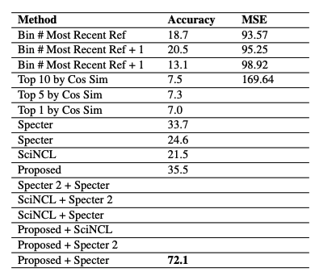
Bin Prediction – Summary
Baseline
Similar Papers
Embedding
Combinations
Notes:
Will be done before tomo morning!

Slide 40
Time Period Prediction – Future work
Consider other features
Min / max / median of time bins of references
Distribution of time bins of references
Improve data preprocessing
Try other model types
Extend to other tasks
Venue prediction
Reviewer matching
Collaborator search
AI2 Bridger

